Slide 1

It’s all bits!
Acknowledgment and Disclaimer: This presentation is supported in part by the National Science Foundation under Grants 1240841, 1225680, 1225719, 1225745, 1225976, and 1226216. Any opinions, findings, and conclusions or recommendations expressed in these materials are those of the authors and do not necessarily reflect the views of the National Science Foundation.
Notes:
*

Slide 2
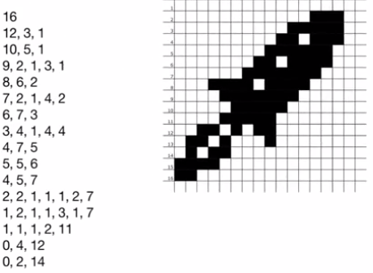
Run-Length Encoding (RLE)
RLE compression
# white pixels, # blacks, # whites, …
16: Row 1 has 16 white pixels
12, 3, 1 : Row 2 has 12 white, 3 black, 1 white
Notes:
*

Slide 3
Run-Length Encoding (RLE)
RLE is a lossless compression technique.
Good for images with lots of whitespace.
E.g., Fax images
Used in BMP (bitmap) images
Notes:
*

Slide 4
Lossless vs. Lossy Compression
Lossless: original image can be perfectly reconstructed from the compressed data.
Good for medical, archival images.
Used in BMP (bitmap) images
Lossy: some data may be lost during compression
Ok for camera images where the lost data cannot be perceived by the human eye.
For example, JPEG
Notes:
*

Slide 5
How much data?
RLE
Original Image
62 numbers
256 pixels
16 by 16
Notes:
*

Slide 6
How much compression?
RLE
Original Image
256 pixels
16 by 16
62 numbers
How much? Depends on how many bits per pixel
Notes:
*

Slide 7

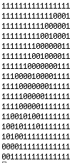
Monochrome Image
1 bit per pixel
256 pixels requires 256 bits
1 = white, 0 = black
Old technique, 1960s
Notes:
*

Slide 8
Monochrome: How much data?
Compressed
Image
Original
Image
Notes:
*

Slide 9
Monochrome: How much data?
Compressed
Image
Original
Image
256 pixels
1 bit/pixel
256 bits
Notes:
*

Slide 10
Monochrome: How much data?
Compressed
Image
Original
Image
62 numbers
8 bits/number
496 bits
256 pixels
1 bit/pixel
256 bits
Notes:
*

Slide 11

Monochrome: How much data?
Compressed
Image
Original
Image
62 numbers
8 bits/number
496 bits
256 pixels
1 bit/pixel
256 bits
>
Notes:
*

Slide 12
8-bit Color Image
Old technique, 1980s
Red, Green, Blue (RGB)
8 bits per pixel
3 R, 3 G, 2 B
0 1 2 3 4 5 6 7
R R R G G G B B
1 1 1 0 0 0 1 1
0000 0000 = black (0)
1111 1111 = white (255)
Notes:
*

Slide 13

Modified RLE
If there are more than 2 colors, RLE needs two numbers per run: the color and the run length
255,16
255,12, 0,3 255,1
255,10, 0,5, 255,1
255,9, 0,2, 255,1, 0,3, 255,1
255,8, 0,6, 255,2
255,7, 0,2, 255,1, 0,4, 255,2
255,6, 0,7, 255,3
255,3, 0,5, 255,1, 0,4, 255,4
255,4, 0,7, 255,5
255,5, 0,5, 255,6
255,4, 0,5, 255,7
255,2, 0,2, 255,1, 0,1, 255,1, 0,2, 255,7
255,1, 0,2, 255,1, 0,1, 255,3, 0,1 255,7
255,1, 0,1, 255,1, 0, 2, 255, 11
255,0, 0,4, 255,12
255,0, 0,2, 255,14
Notes:
*

Slide 14
Modified RLE
If there are more than 2 colors, RLE needs two numbers per run: the color and the run length
255,16
255,12, 0,3 255,1
255,10, 0,5, 255,1
255,9, 0,2, 255,1, 0,3, 255,1
255,8, 0,6, 255,2
255,7, 0,2, 255,1, 0,4, 255,2
255,6, 0,7, 255,3
255,3, 0,5, 255,1, 0,4, 255,4
255,4, 0,7, 255,5
255,5, 0,5, 255,6
255,4, 0,5, 255,7
255,2, 0,2, 255,1, 0,1, 255,1, 0,2, 255,7
255,1, 0,2, 255,1, 0,1, 255,3, 0,1 255,7
255,1, 0,1, 255,1, 0, 2, 255, 11
255,0, 0,4, 255,12
255,0, 0,2, 255,14
Twice as many numbers
124 numbers
8 bits/number
992 bits
Notes:
*

Slide 15
Modified RLE
Compressed Image
Original
Image
255,16
255,12, 0,3 255,1
255,10, 0,5, 255,1
255,9, 0,2, 255,1, 0,3, 255,1
255,8, 0,6, 255,2
255,7, 0,2, 255,1, 0,4, 255,2
255,6, 0,7, 255,3
255,3, 0,5, 255,1, 0,4, 255,4
255,4, 0,7, 255,5
255,5, 0,5, 255,6
255,4, 0,5, 255,7
255,2, 0,2, 255,1, 0,1, 255,1, 0,2, 255,7
255,1, 0,2, 255,1, 0,1, 255,3, 0,1 255,7
255,1, 0,1, 255,1, 0, 2, 255, 11
255,0, 0,4, 255,12
255,0, 0,2, 255,14
Notes:
*

Slide 16
Modified RLE
Compressed Image
Original
Image
255,16
255,12, 0,3 255,1
255,10, 0,5, 255,1
255,9, 0,2, 255,1, 0,3, 255,1
255,8, 0,6, 255,2
255,7, 0,2, 255,1, 0,4, 255,2
255,6, 0,7, 255,3
255,3, 0,5, 255,1, 0,4, 255,4
255,4, 0,7, 255,5
255,5, 0,5, 255,6
255,4, 0,5, 255,7
255,2, 0,2, 255,1, 0,1, 255,1, 0,2, 255,7
255,1, 0,2, 255,1, 0,1, 255,3, 0,1 255,7
255,1, 0,1, 255,1, 0, 2, 255, 11
255,0, 0,4, 255,12
255,0, 0,2, 255,14
256 pixels
8 bits/pixel
2048 bits
Notes:
*

Slide 17
Modified RLE
Compressed Image
Original
Image
255,16
255,12, 0,3 255,1
255,10, 0,5, 255,1
255,9, 0,2, 255,1, 0,3, 255,1
255,8, 0,6, 255,2
255,7, 0,2, 255,1, 0,4, 255,2
255,6, 0,7, 255,3
255,3, 0,5, 255,1, 0,4, 255,4
255,4, 0,7, 255,5
255,5, 0,5, 255,6
255,4, 0,5, 255,7
255,2, 0,2, 255,1, 0,1, 255,1, 0,2, 255,7
255,1, 0,2, 255,1, 0,1, 255,3, 0,1 255,7
255,1, 0,1, 255,1, 0, 2, 255, 11
255,0, 0,4, 255,12
255,0, 0,2, 255,14
124 numbers
8 bits/number
992 bits
256 pixels
8 bits/pixel
2048 bits
Notes:
*

Slide 18

Modified RLE
Compressed Image
Original
Image
255,16
255,12, 0,3 255,1
255,10, 0,5, 255,1
255,9, 0,2, 255,1, 0,3, 255,1
255,8, 0,6, 255,2
255,7, 0,2, 255,1, 0,4, 255,2
255,6, 0,7, 255,3
255,3, 0,5, 255,1, 0,4, 255,4
255,4, 0,7, 255,5
255,5, 0,5, 255,6
255,4, 0,5, 255,7
255,2, 0,2, 255,1, 0,1, 255,1, 0,2, 255,7
255,1, 0,2, 255,1, 0,1, 255,3, 0,1 255,7
255,1, 0,1, 255,1, 0, 2, 255, 11
255,0, 0,4, 255,12
255,0, 0,2, 255,14
124 numbers
8 bits/number
992 bits
256 pixels
8 bits/pixel
2048 bits
<
Notes:
*

Slide 19
24-bit Color Image
Red, Green, Blue (RGB)
24 bits per pixel
8 R, 8 G, 8 B
2²⁴ = 16,777,216 colors
More than we can see
3 numbers for each pixel
0,0,0 = black
255,255,255 = white
255, 0, 200 =
Notes:
*

Slide 20
24-bit Color Image
Four times as many numbers
248 numbers with 8 bits/number
1984 bits
255,255,255,16
255,255,255,12, 0,0,0,3 255,255,255,1
…
255,255,255,0, 0,0,0,4, 255,255,255,12
255,255,255,0, 0,0,0,2, 255,255,255,14
Notes:
*

Slide 21
24-bit Color Image
Compressed Image
Original
Image
255,255,255,16
255,255,255,12, 0,0,0,3 255,255,255,1
…
255,255,255,0, 0,0,0,4, 255,255,255,12
255,255,255,0, 0,0,0,2, 255,255,255,14
Notes:
*

Slide 22
24-bit Color Image
Compressed Image
Original
Image
255,255,255,16
255,255,255,12, 0,0,0,3 255,255,255,1
…
255,255,255,0, 0,0,0,4, 255,255,255,12
255,255,255,0, 0,0,0,2, 255,255,255,14
256 pixels
24 bits/pixel
6,144 bits
Notes:
*

Slide 23
24-bit Color Image
Compressed Image
Original
Image
255,255,255,16
255,255,255,12, 0,0,0,3 255,255,255,1
…
255,255,255,0, 0,0,0,4, 255,255,255,12
255,255,255,0, 0,0,0,2, 255,255,255,14
248 numbers
8 bits/number
1984 bits
256 pixels
24 bits/pixel
6,144 bits
Notes:
*

Slide 24
24-bit Color Image
Compressed Image
Original
Image
255,255,255,16
255,255,255,12, 0,0,0,3 255,255,255,1
…
255,255,255,0, 0,0,0,4, 255,255,255,12
255,255,255,0, 0,0,0,2, 255,255,255,14
248 numbers
8 bits/number
1984 bits
256 pixels
24 bits/pixel
6,144 bits
<
Notes:
*

Slide 25

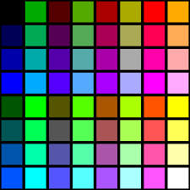
Amount of RLE Compression?
Depends on # bits/pixel
But, even more importantly...
...Depends on # of different colors in the image
The more colors,the more color changes, the more numbers needed.
Notes:
*

Slide 26
We’ve seen binary used to
represent numbers
represent colors
represent machine language
Notes:
*

Slide 27
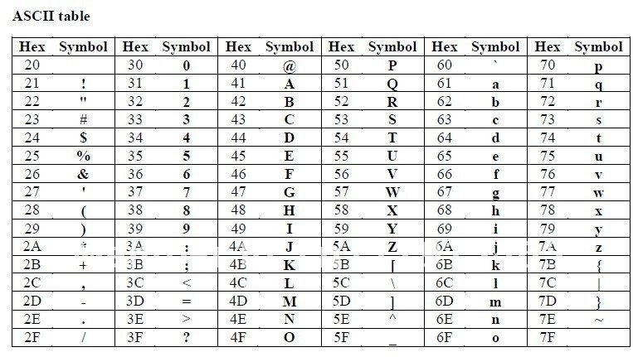
Representing Character Data
American Standard Code for Information Interchange (ASCII), 1960s
7-bit code, 128 characters
Notes:
*

Slide 28
Representing Character Data
ASCII, Some Common Codes
Binary | Hex | Decimal | Character
0010 0000 | 20 | 32 | Space
0011 0000 | 30 | 48 | 0
0100 0001 | 41 | 65 | A
0110 0001 | 61 | 97 | a
Notes:
*

Slide 29
So,...
What does this bit sequence represent?
0100 0001
Notes:
*

Slide 30
So,...
What does this bit sequence represent?
0100 0001
Is it the number 65?
Notes:
*

Slide 31
So,...
What does this bit sequence represent?
0100 0001
Is it the number 65?
Is it the letter ‘A’
Notes:
*

Slide 32
So,...
What does this bit sequence represent?
0100 0001
Is it the number 65?
Is it the letter ‘A’
Is it the color
Notes:
*

Slide 33
It Depends!
on how
0100 0001
is used
in an Image?
a Text Message?
a Spreadsheet?
a machine language code?
Notes:
*

Slide 34
It’s all bits!
Notes:
*

